Slide 1

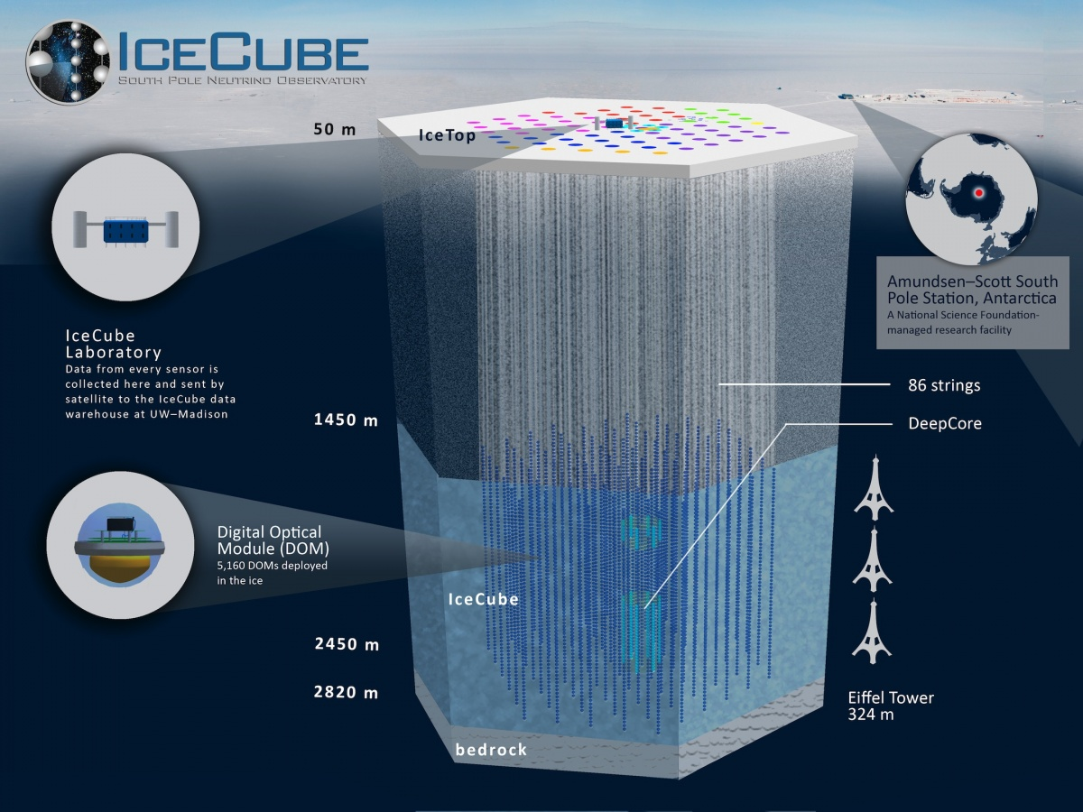
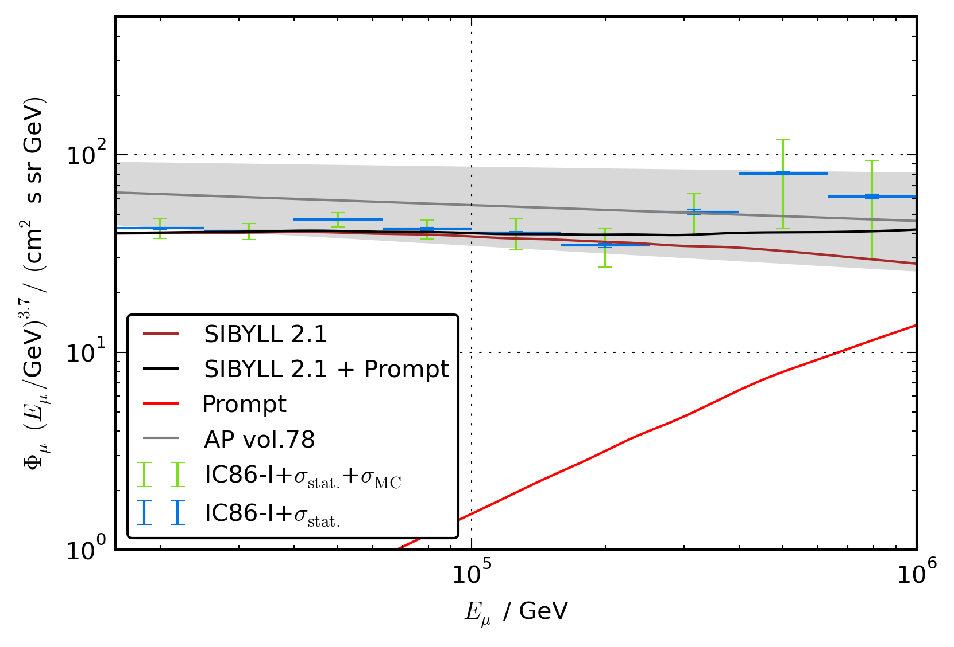
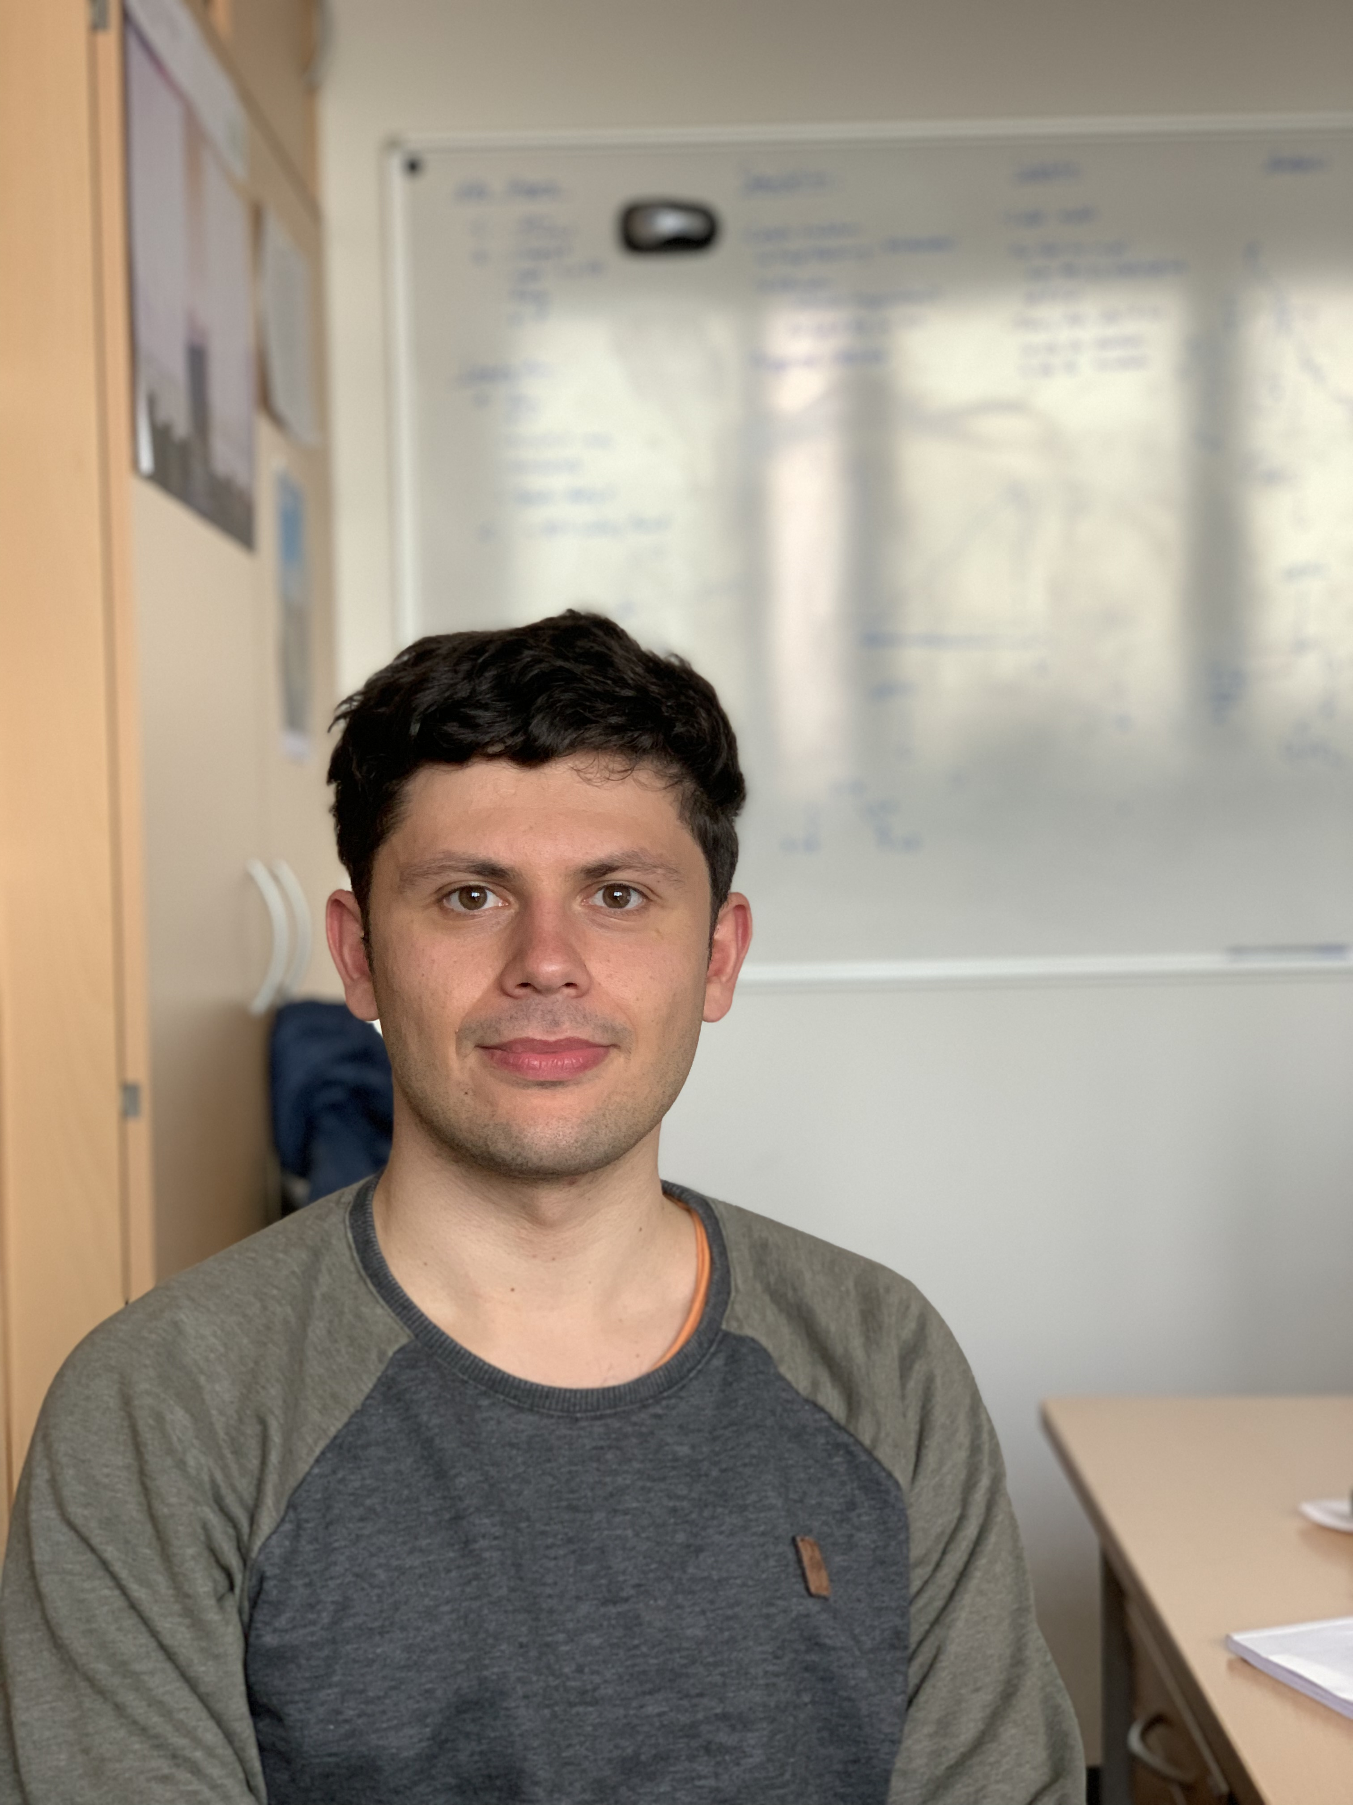
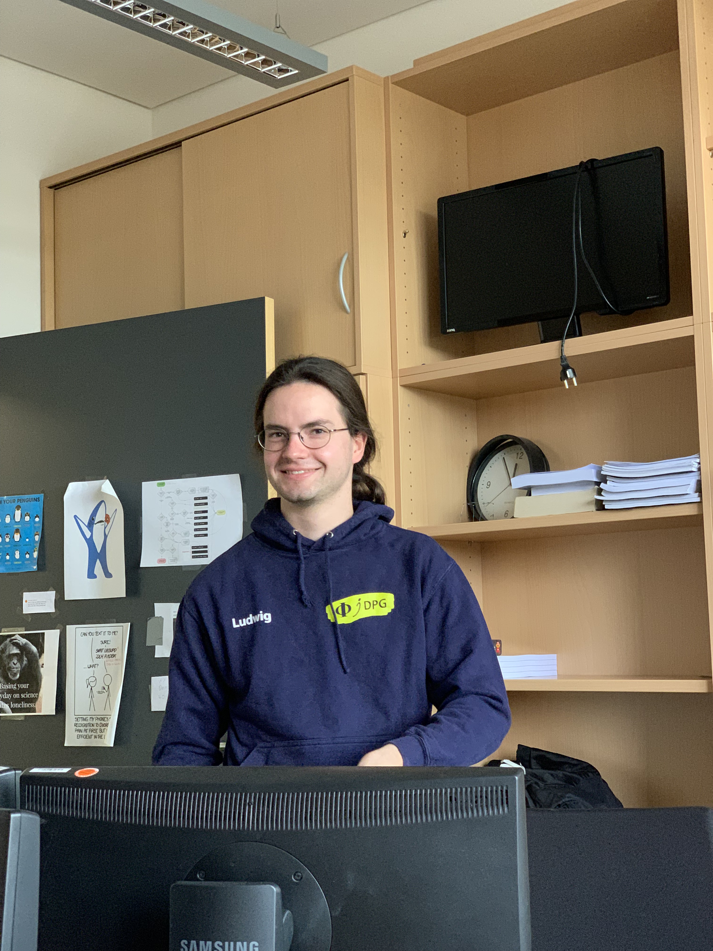


First ideas to measure the prompt component of the atmospheric muon flux
Jean-Marco Alameddine, Ludwig Neste and Pascal Gutjahr
Cosmic Rays in the Multi-Messenger Era Paris 2022
jean-marco.alameddine@tu-dortmund.de
pascal.gutjahr@tu-dortmund.de
The air shower simulation framework
CORSIKA 7 is used to estimate the muon flux at the earth surface. Since a large amount of
prompt muons arise due to charmed parent
particles, the module SIBYLL 2.3d is chosen
to simulate the hadronic interactions. It
includes the latest updates to simulate the
charm component.
To perform a fit of the normalization of the
prompt component, several CORSIKA
datasets should be created via re-weighting
the amount of prompt particles in the air
shower.
Cosmic rays interact with our atmosphere and
produce large air showers including several
types of stable and unstable particles. The
unstable daughter particles decay and muons
can be produced, which are able to reach the
surface of our earth. This atmospheric muon flux
is divided into a conventional and a prompt
component. Conventional muons come from
pions and kaons, which have a long lifetime
compared to the other particles that are defined as prompt. Due to the short lifetime of the prompt parent particles, they decay nearly instantly and do not loose any energy. This results in the fact,
that the prompt muon flux follows the primary
particle flux and dominates at energies higher
than TeV. A current challenge in this topic is the muon puzzle, that describes a mismatch
between the measured muon flux and the
simulated one.
In this analysis, new air shower simulations will
be performed with the latest CORSIKA version including hadronic interaction models describing
the charm component. With this, a new event
sample will be generated to measure the prompt muon flux with the IceCube Neutrino
Observatory. Possibly further contributions can
be made to the muon puzzle.
Simulation
Introduction
masterclass.icecube.wisc.edu
Unfolding
unfold the muon flux in energy bins
Fit of normalization
scaling of the prompt muon component
$$Φ_{tot}= Φ_{conv}+ Φ_{prompt}$$
Analysis idea
Atmospheric Muon Flux
Analysis by Tomasz Fuchs, fit of normalization compatible with zero, to less MC statistics (Figure 6.16)
prompt analysis in IceCube 2016 – zenith problem (Table 9, Figure 28/29/30)
Which problems were in the former analyses?
Former Analyses
First Results
CORSIKA tagging vs. MCEq
DYNSTACK
FIGURE with muon flux divided into different parent particles
What are the resource constraints of your
methods/algorithms/application?
Which constraints apply to the hardware you
are using?
Work in Progress
Conclusion
What conclusions can be drawn from the study? What are the key outcomes / discoveries?
Outlook
What should/could/must be worked on further
in the future?
What subsequent research questions arise?
References
[1]
Jean-Marco
Ludwig
Pascal
This is an infobox environment, floated to the bottom
because the previous box did not use a star variant of plainbox
⋆ This work has been supported by the DFG, Collaborative Research Center SFB 876 (project C3) and Collaborative Research Center SFB 1491 (project F3) as well as by the BMBF, project 05A20PEA.
Notes:
Seitenlayout eingestellt auf Din A0: 84,1cm x 118,9cm

